Slide 1
Stemmer & lemmatization

Slide 2
what is stemming
It is the process of reducing the word to its word stem that affixes to suffixes and prefixes or to roots of words known as a lemma. In simple words stemming is reducing a word to its base word or stem in such a way that the words of similar kind lie under a common stem. For example – The words care, cared and caring lie under the same stem ‘care’. Stemming is important in natural language processing(NLP).

Slide 3
Content:
Stemmer
Porter
stemmer
Lancaster stemmer
Snowball stemmer

Slide 4
Lancaster Stemmer
Iterative algorithm with rules saved externally.
Aggressive .
Simple ,but heavy stemming due to iterations and over-stemming may occur.
Over-stemming causes the stems to be not linguistic, or they may have no meaning.

Slide 5
Lancaster stemmer
It is an iterative algorithm with rules saved externally.
One table containing about 120 rules indexed by the last letter of a suffix.
On each iteration, it tries to find an applicable rule by the last character of the word.
Each rule specifies either a deletion or replacement of an ending.
If there is no such rule, it terminates.
It also terminates:
if a word starts with a consonant and there are only three characters left.
if a word starts with a vowel and there are only two letters left .
Otherwise, the rule is applied, and the process repeats.

Slide 6
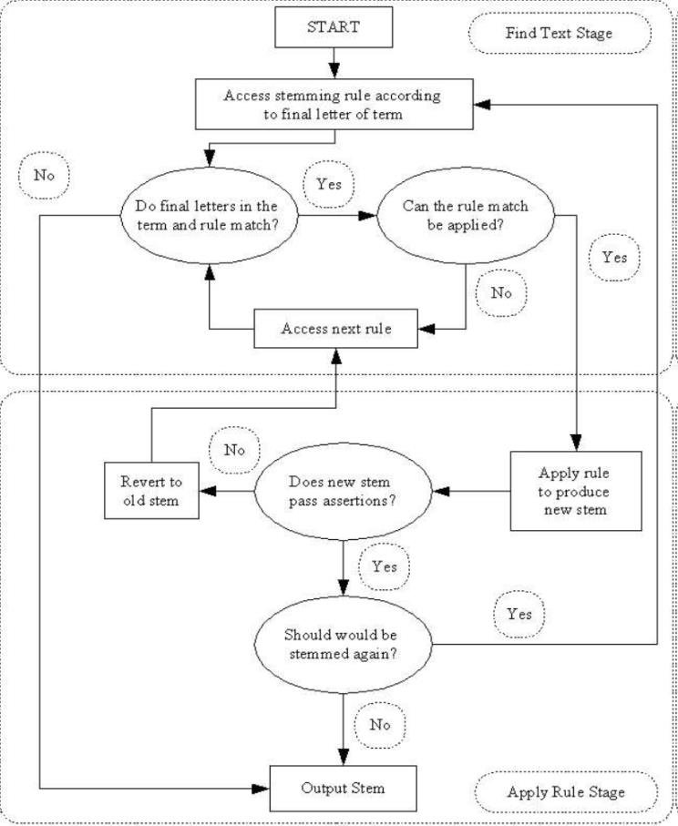
Steps of Lancaster stemmer

Slide 7
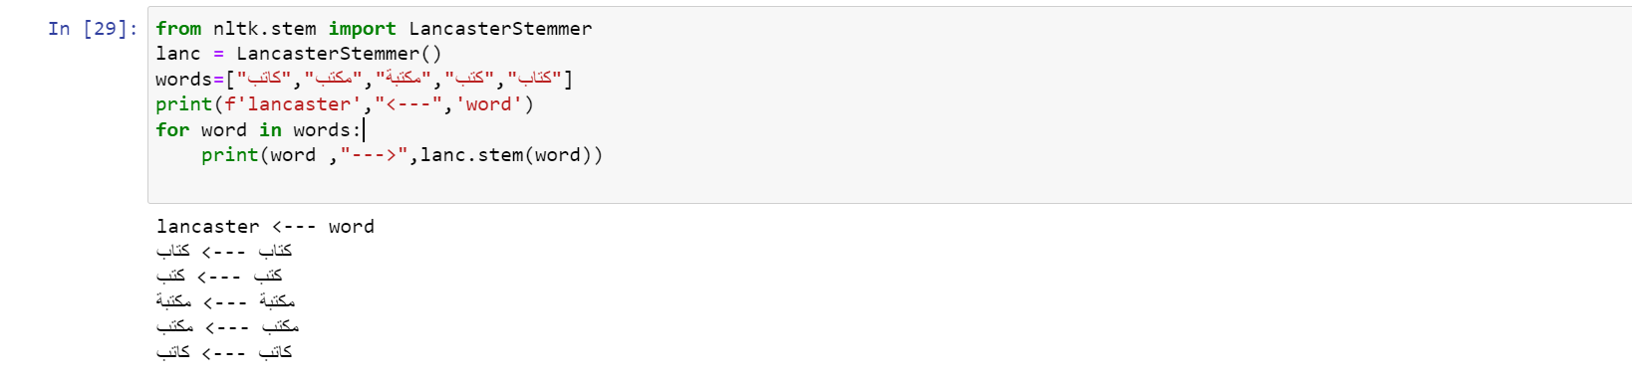

Slide 8
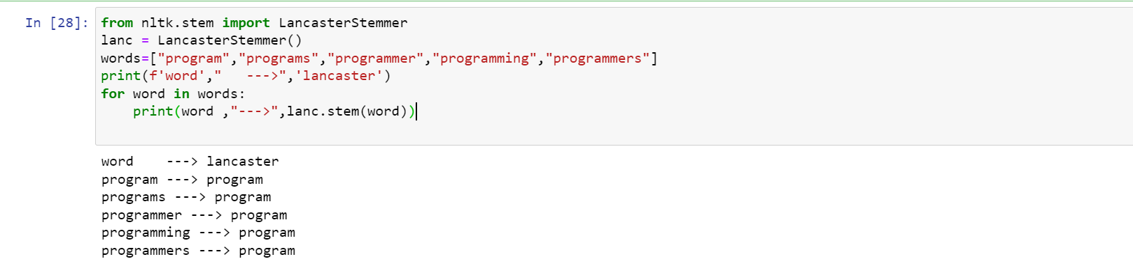

Slide 9
Porter stemmer
Most common stemming algorithm
Fast ,imprecise.
It is commonly useful in Information Retrieval Environments known as IR Environments for fast recall and fetching of search queries.
uses Suffix Stripping to produce stems.
the resultant stem is a shorter word with the same root meaning.

Slide 10
Porter stemmer
PorterStemmer algorithm does not follow linguistics rather a set of steps.
Five steps of word reduction are used in the method, each with its own set of mapping rules.

Slide 11
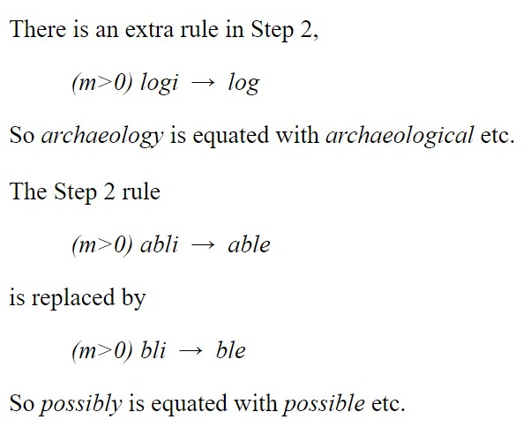
Points of difference from the published algorithm
Notes:
The algorithm leaves alone strings of length 1 or 2. In any case a string of length 1 will be unchanged if passed through the algorithm, but strings of length 2 might lose a final s, so as goes to a and is to i.
These differences may have been present in the program from which the published algorithm derived. But at such a great distance from the original publication it is now difficult to say.
It must be emphasised that these differences are very small indeed compared to the variations that have been observed in other encodings of the algorithm.

Slide 12
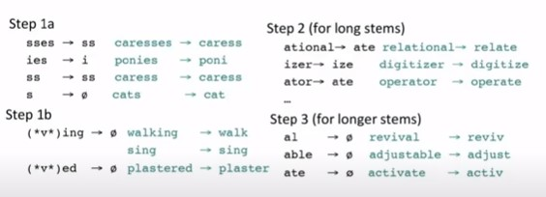
This can be applied to some words, including what succeeds and they fail

Slide 13
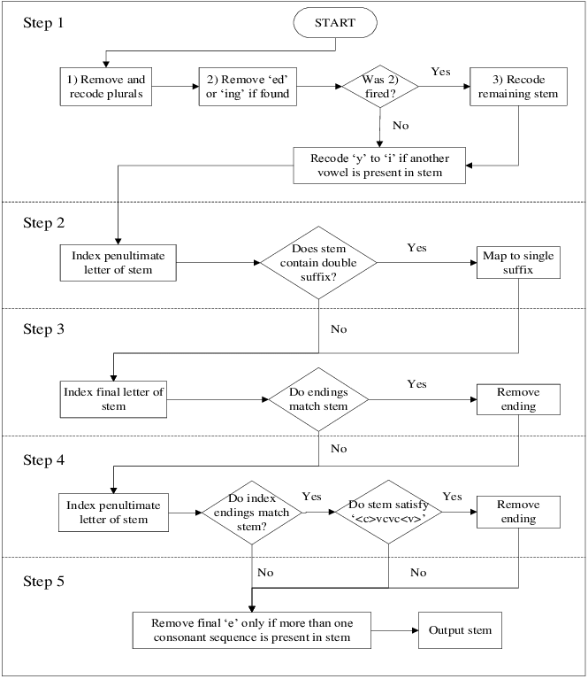
Porter stemmer
Notes:
Common errors: This leads to small errors in various places, for example in the Step 4 rules
(m>1)ement →
(m>1)ment →
(m>1)ent →
to remove final ement, ment and ent.
Properly, argument stems to argument. The longest matching suffix is -ment. Then stem argu- has measure m equal to 1 and so -ment will not be removed. End of Step 4. But if the three rules are applied in turn, then for suffix -ent the stem argum- has measure m equal to 2, and -ent gets removed.
The more delicate rules are liable to misinterpretation. (Perhaps greater care was required in explaining them.) So
((m>1) and (*s or *t))ion
is taken to mean
(m>1)(s or t)ion
The former means that taking off -ion leaves a stem with measure greater than 1 ending -s or -t; the latter means that taking off -sion or -tion leaves a stem of measure greater than 1. A similar confusion tends to arise in interpreting rule 5b, to reduce final double L to single L.
Occasionally cruder errors have been seen. For example the test for Y being consonant or vowel set up the wrong way round.
It is interesting that although the published paper explains how to do the tests on the strings S1 by a program switch on the last or last but one letter, many encodings fail to use this technique, making them much slower than they need be.

Slide 14
FAQs (frequently asked questions)
Why is the stemmer not producing proper words? It is often taken to be a crude error that a stemming algorithm does not leave a real word after removing the stem. But the purpose of stemming is to bring variant forms of a word together, not to map a word onto its ‘paradigm’ form. And connected with this,
Why are there errors? The question normally comes in the form, why should word X be stemmed to x1, when one would have expected it to be stemmed to x2? It is important to remember that the stemming algorithm cannot achieve perfection. On balance it will (or may) improve IR performance, but in individual cases it may sometimes make what are, or what seem to be, errors. Of course, this is a different matter from suggesting an additional rule that might be included in the stemmer to improve its performance.

Slide 15
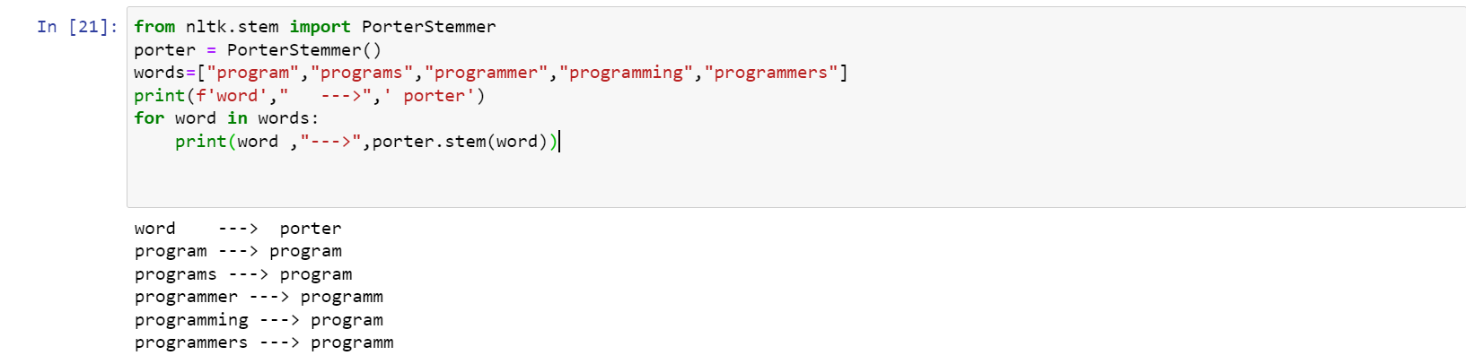

Slide 16
Snowball Stemmer

Slide 17
What is Snowball Stemmer
Snowball is a small string processing language for creating stemming algorithms for use in Information Retrieval, plus a collection of stemming algorithms implemented using it.
Snowball was originally designed and built by Martin Porter. Martin retired from development in 2014 and Snowball is now maintained as a community project. Martin originally chose the name Snowball as a tribute to SNOBOL, the excellent string handling language from the 1960s. It now also serves as a metaphor for how the project grows by gathering contributions over time.
The Snowball compiler translates a Snowball program into source code in another language - currently Ada, ISO C, C#, Go, Java, Javascript, Object Pascal, Python and Rust are supported.
If you want to always reduce words to a root form and/or get a root form which is itself a word then Snowball's stemming algorithms likely aren't the right answer.
Notes:
This stem form is often a word itself, but this is not always the case as this is not a requirement for text search systems, which are the intended field of use. We also aim to conflate words with the same meaning, rather than all words with a common linguistic root (so awe and awful don't have the same stem), and over-stemming is more problematic than under-stemming so we tend not to stem in cases that are hard to resolve. If you want to always reduce words to a root form and/or get a root form which is itself a word then Snowball's stemming algorithms likely aren't the right answer.

Slide 18
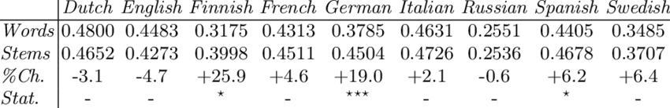
Snowball stemming algorithm.

Slide 19
For More Understanding What is details of Algorithm
Please Check This Link snowman.html

Slide 20
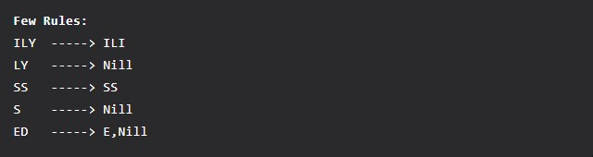
Some few common rules of Snowball stemming are:
Notes:
Nill means the suffix is replaced with nothing and is just removed.
There may be cases where these rules vary depending on the words. As in the case of the suffix ‘ed’ if the words are ‘cared’ and ‘bumped’ they will be stemmed as ‘care‘ and ‘bump‘. Hence, here in cared the suffix is considered as ‘d’ only and not ‘ed’. One more interesting thing is in the word ‘stemmed‘ it is replaced with the word ‘stem‘ and not ‘stemmed‘. Therefore, the suffix depends on the word.

Slide 21
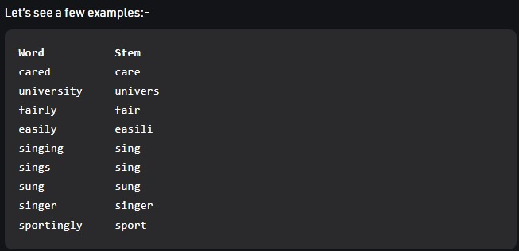
Let’s see a few examples:-

Slide 22
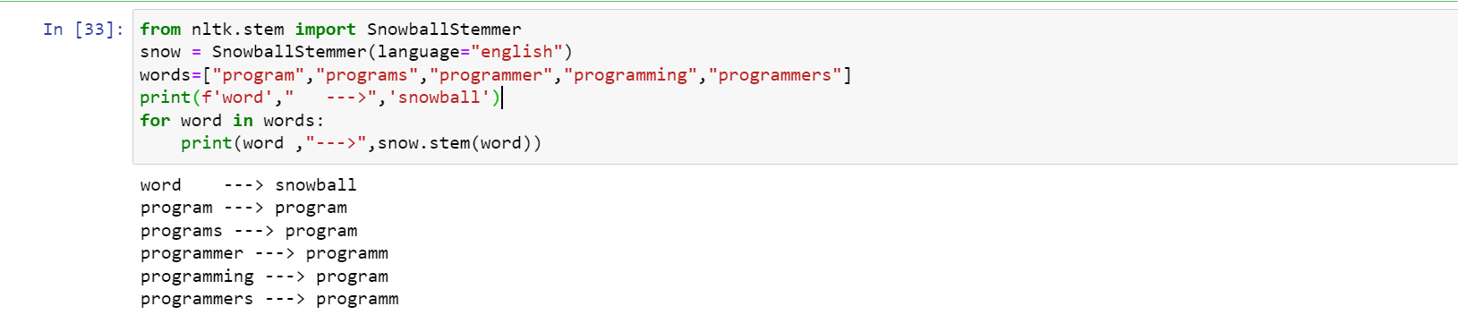

Slide 23
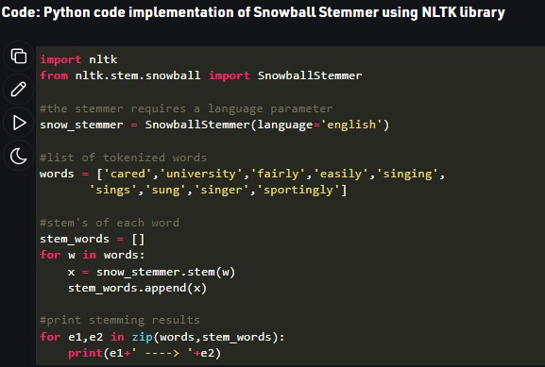
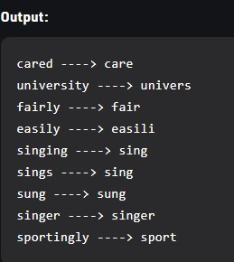

Slide 24
Difference Between Porter Stemmer and Snowball Stemmer:
Snowball Stemmer is more aggressive than Porter Stemmer.
Some issues in Porter Stemmer were fixed in Snowball Stemmer.
There is only a little difference in the working of these two.
Words like ‘fairly‘ and ‘sportingly‘ were stemmed to ‘fair’ and ‘sport’ in the snowball stemmer but when you use the porter stemmer they are stemmed to ‘fairli‘ and ‘sportingli‘.
The difference between the two algorithms can be clearly seen in the way the word ‘Sportingly’ in stemmed by both. Clearly Snowball Stemmer stems it to a more accurate stem.

Slide 25
Drawbacks of Stemming:
Issues of over stemming and under stemming may lead to not so meaningful or inappropriate stems.
Stemming does not consider how the word is being used. For example – the word ‘saw‘ will be stemmed to ‘saw‘ itself but it won’t be considered whether the word is being used as a noun or a verb in the context. For this reason, Lemmatization is used as it keeps this fact in consideration and will return either ‘see’ or ‘saw’ depending on whether the word ‘saw’ was used as a verb or a noun.

Slide 26
More
Examples

Slide 27
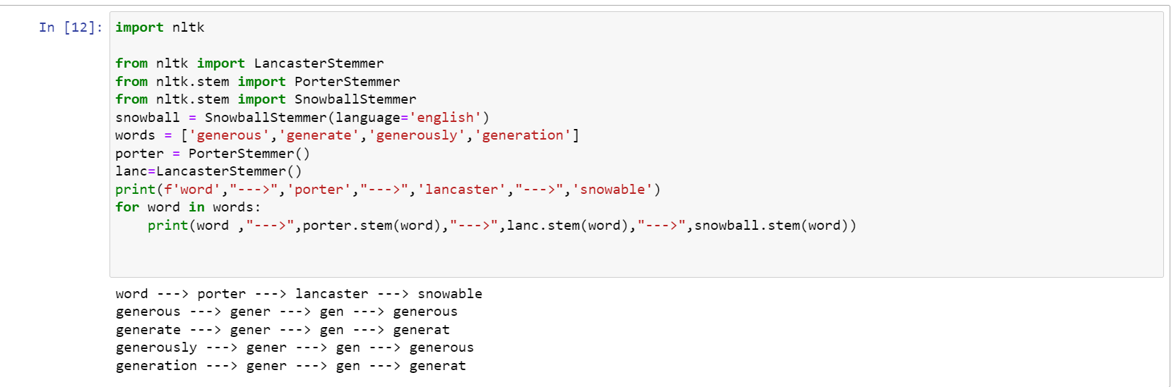

Slide 28
Our References
The Porter Stemming Algorithm
Snowball
Snowball Manual
Snowball Stemming language and algorithms Repo
Snowball stemming algorithm.
Snowball site

Slide 29

Thank you

